Slide 1
2 DOF Self-Balancing Robot
Team: [Apurv Sambhare(H095)], [Chaitanya Sontakke(H093)]
Course: Dynamic System Modeling (702MH0C023)
B.Tech Mechatronics, Sem IV | NMIMS MPSTME Mumbai
Category: [C] | Complexity: [Medium]
COs Exercised: [CO1, CO2, CO3, CO4, CO5] | Date: [24/04/2026]

Slide 2
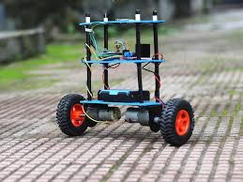
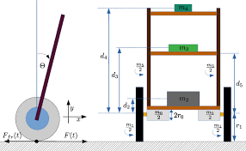
2 DOF Self-Balancing Robot-Introduction
System Description
The selected system is a two-wheeled self-balancing robot model as an Inverted Pendulum mounted on a moving base. The objective of the system is to maintain an upright position by dynamically adjusting wheel motion in response to tilt.
Real-World Applications
Personal Transport Systems
Self-balancing robots are used in devices like the Segway PT, where dynamic balancing allows smooth and stable human transportation.
Warehouse & Industrial Robotics
Used in autonomous robots for material handling, where balance control enables efficient navigation in tight spaces and uneven loads
Problem Statement
The objective is to model and simulate a two-wheeled self-balancing robot, which behaves like an Inverted Pendulum. The system is inherently unstable and requires motor torque input to maintain upright balance. The goal is to derive its equations of motion, simulate the dynamics, and analyze stability under disturbances.
Notes:
TIMING: 0:00-1:00 (1 min)
FOCUS: Introduce your system and its real-world engineering relevance.
TIP: Start with a compelling application, not a textbook definition.
SHOW: An image or short video of the actual system.

Slide 3
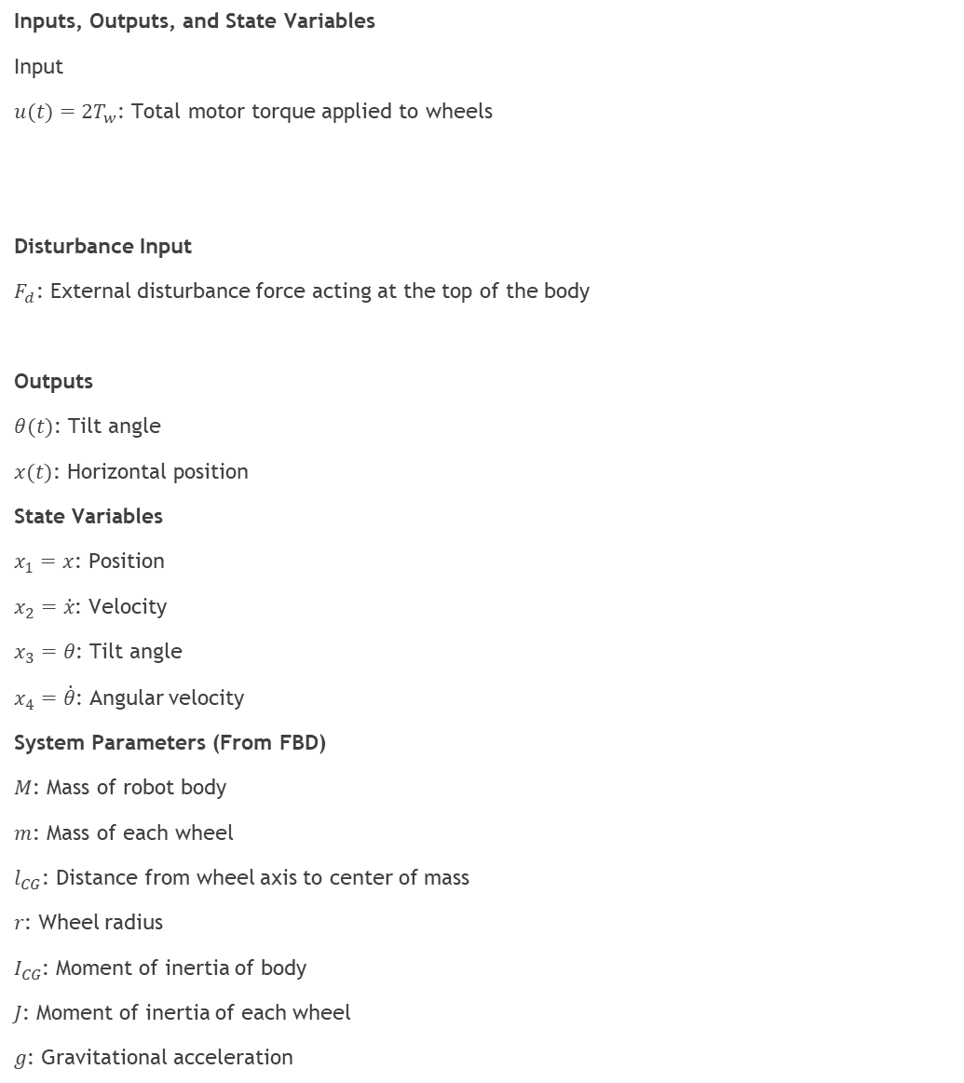
Problem Formulation & Assumptions
Inputs, Outputs, and State Variables
Input
$u(t)=2T_{w}$: Total motor torque applied to wheels
Disturbance Input
$F_{d}$: External disturbance force acting at the top of the body
Outputs
$θ(t)$: Tilt angle
$x(t)$: Horizontal position
State Variables
$x_{1}=x$: Position
$x_{2}=\dot{x}$: Velocity
$x_{3}=θ$: Tilt angle
$x_{4}=\dot{θ}$: Angular velocity
System Parameters (From FBD)
$M$: Mass of robot body
$m$: Mass of each wheel
$l_{CG}$: Distance from wheel axis to center of mass
$r$: Wheel radius
$I_{CG}$: Moment of inertia of body
$J$: Moment of inertia of each wheel
$g$: Gravitational acceleration
Assumptions with Physical Justification
No Slip Condition
Wheels roll without slipping ensures x=rϕ
Rigid Body Approximation
Body and wheels do not deform
Planar Motion
Motion restricted to 2D plane justified by symmetric wheels
Negligible Air Resistance
Effect is very small compared to gravity and motor forces
Uniform Mass Distribution
Allows use of I_CGas constant
Notes:
TIMING: 1:00-2:30 (1.5 min)
FOCUS: Clearly define I/O, states, parameters, DOF, and justify every assumption.
TIP: Explain WHY each assumption is physically valid.
BE PREPARED: You may be asked 'Why this assumption? What if it changes?'

Slide 4
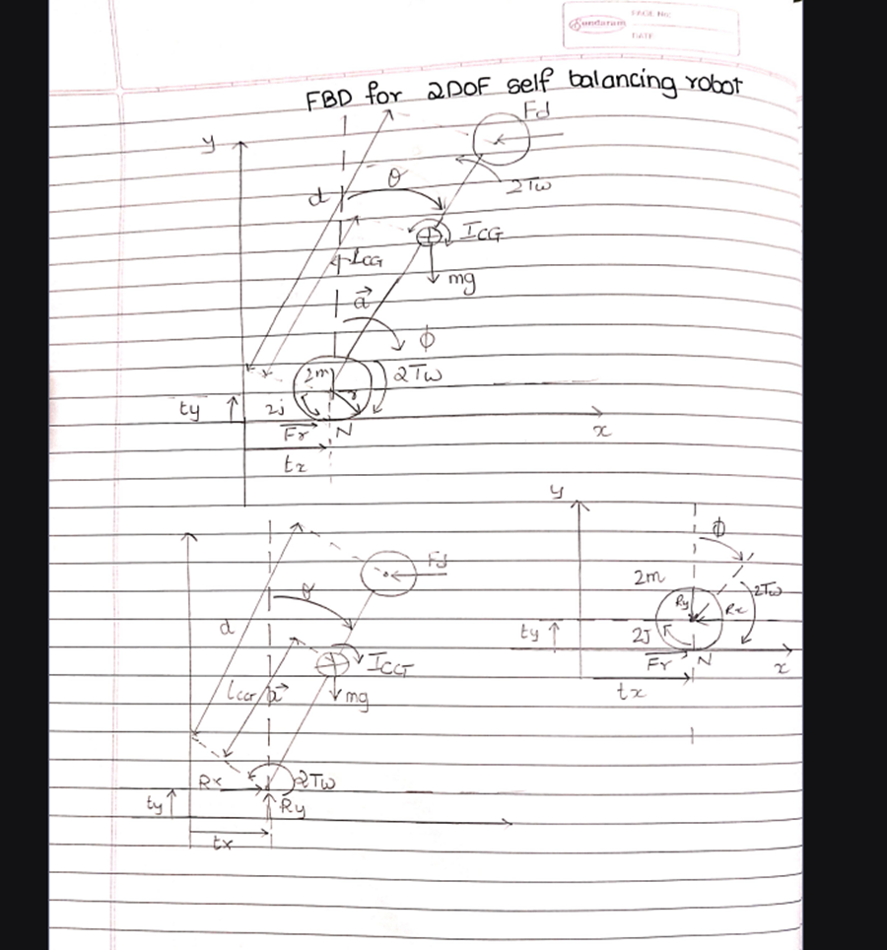
FBD-2 DOF Self-Balancing Robot
.

Slide 5
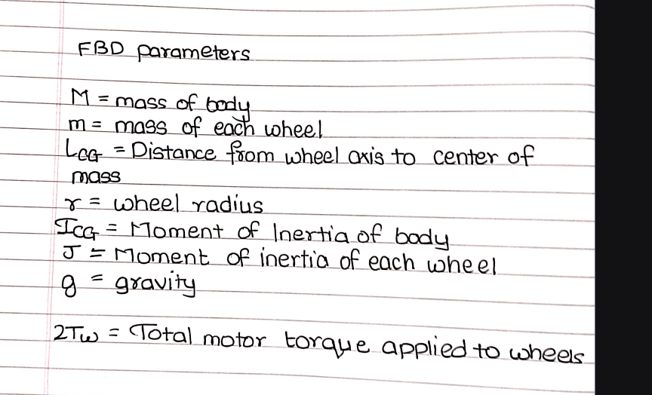
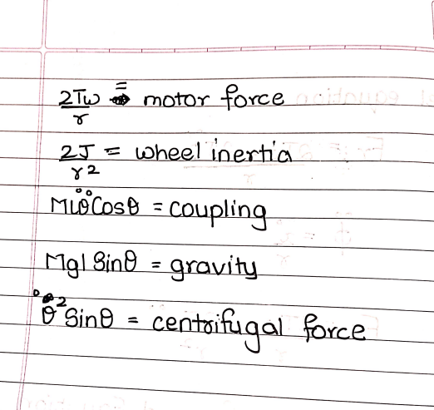
Mathematical model equations of 2 DOF Self-Balancing Robot
Notes:
TIMING: 2:30-3:45 (1.25 min)
FOCUS: Walk through EVERY step of the derivation. This is the most important section.
TIP: Show the algebra — don't skip to the final equation.
BE PREPARED: You may be asked to explain any step in detail.

Slide 6
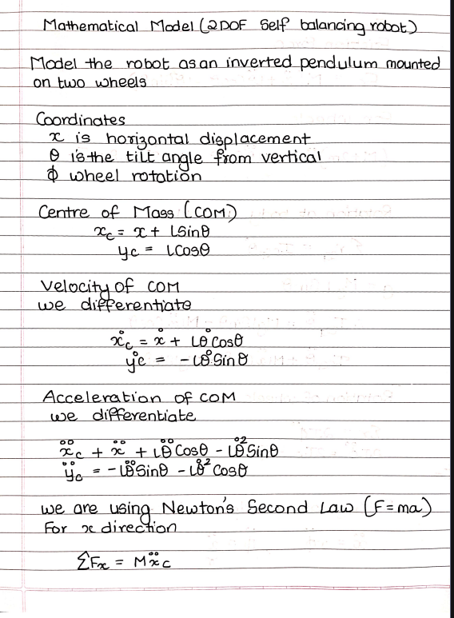

Slide 7
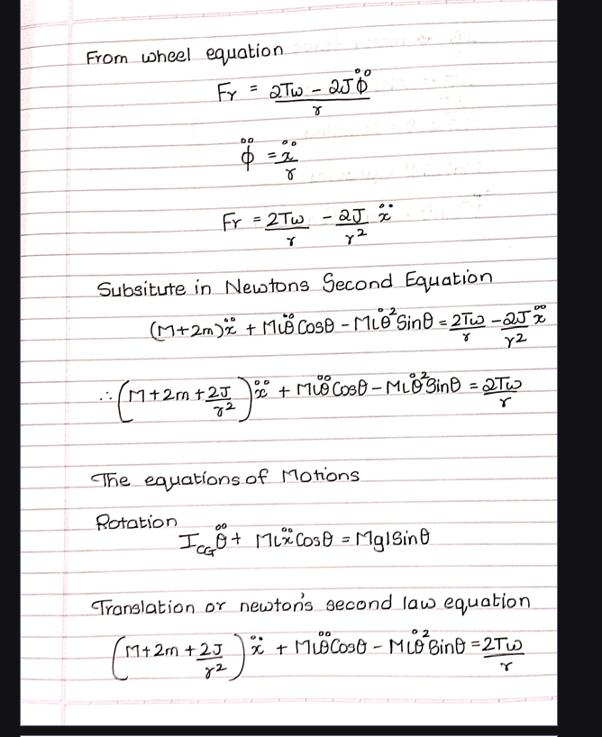

Slide 8
5. Final Equations & State-Space
Notes:
TIMING: 3:45-5:00 (1.25 min)
FOCUS: Present final EOM and state-space. Explain the physical meaning of EVERY term.
TIP: 'c*x_dot = viscous damping force' is stronger than just showing the equation.

Slide 9
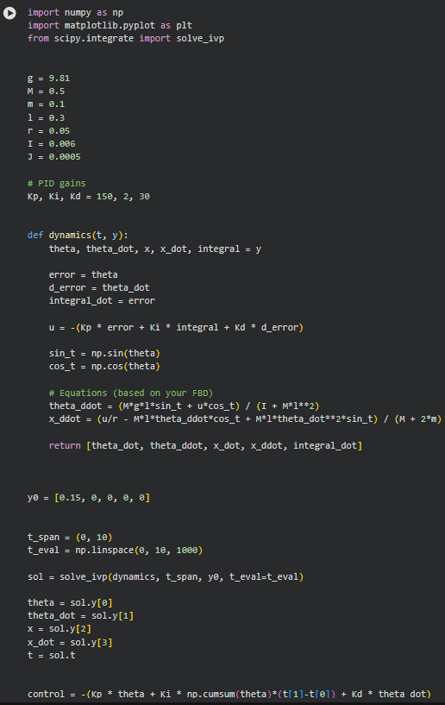
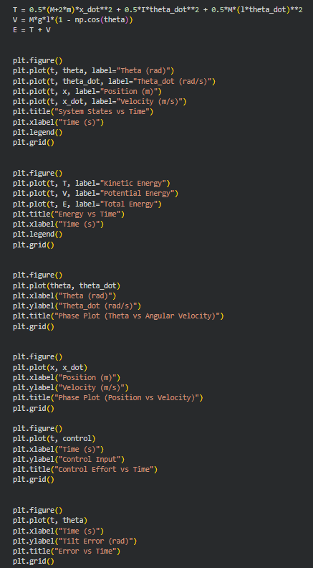
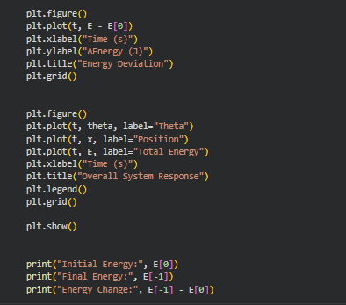
Simulation & Energy Analysis
Notes:
TIMING: 5:00-7:00 (2 min)
FOCUS: Show your simulation setup, key code snippet, and output plots.
INCLUDE: Energy vs time plot — this validates your model physically.
BE PREPARED: You may be asked 'Why does the oscillation decay?' or 'How does energy change?'

Slide 10
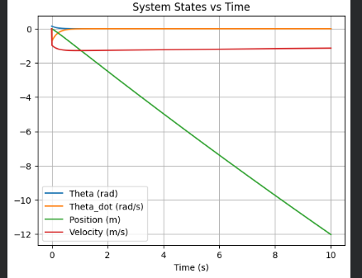
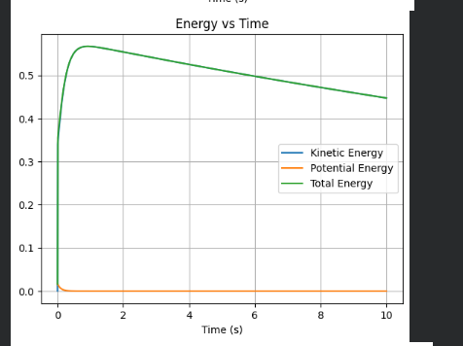
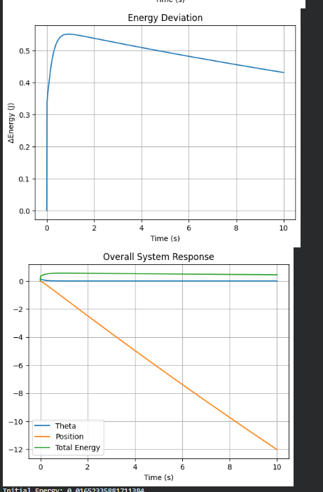
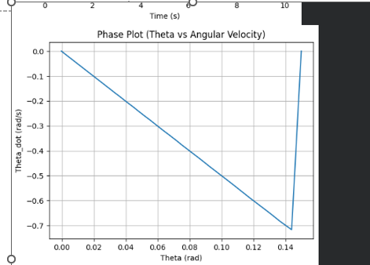
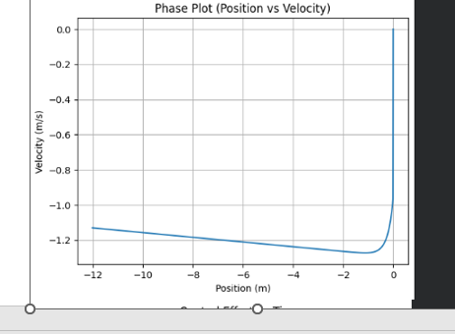
7. Simulation Visualization

Slide 11
8. Validation & Analysis
Validation 1: Energy conservation check (CO5)
Total energy [conserved / decays X% from damping]
Validation 2: Comparison with analytical/published result (CO4)
Textbook: Ginsberg Ch X → w_n = ...; Our sim: w_n = ...
Validation 3: Dimensional analysis / unit check
Sensitivity Analysis:
Varied [param] from [range] → [effect on natural freq/stability]
Limitations:
(1) [e.g., Rigid body limits to low-speed regime]
(2) [e.g., No experimental validation — simulation only]
Notes:
TIMING: 7:00-8:30 (1.5 min)
FOCUS: Show HOW you verified your results. Energy check, textbook comparison, sensitivity.
TIP: A strong answer = 'We compared natural frequency with Ginsberg Ch.3.'
A weak answer = 'It runs and produces output.'

Slide 12
9. Conclusions & Reflections
Conclusion
The 2 DOF self-balancing robot was successfully modeled as an Inverted Pendulum using Newton’s laws.
The derived nonlinear equations of motion were implemented in Python and solved using numerical methods.
Simulation results show that the system stabilizes under control, with tilt angle approaching zero.
Energy analysis confirms non-conservative behavior due to external motor torque input, and sensitivity analysis shows physically consistent response to parameter changes.
Final Outcome:
The mathematical model and simulation accurately represent the real system dynamics and validate the effectiveness of the control approach.
Notes:
TIMING: 8:30-10:00 (1.5 min)
FOCUS: Be specific about what you learned and what was hardest.
TIP: 'Getting the sign convention right in the Lagrangian took 3 iterations' is much stronger than 'teamwork was hard.'
INCLUDE: CO self-assessment — which COs did you exercise most?

Slide 13
10. References & AI Disclosure
Online Resources:
https://www.ijltemas.in/
https://www.researchgate.net/
AI Tools (Disclosure)
Tool: ChatGPT
Purpose: Assistance with Python code structure, simulation setup, and explanation of concepts
NOT used for: Final derivation (done manually), FBD creation, and conceptual understanding
Notes:
AI disclosure is MANDATORY but NOT penalized.
Be honest about what tools you used and for what purpose.
Good: 'Used ChatGPT for Python syntax debugging, derivation done by hand.'
Non-disclosure IS penalized if uncovered during Q&A.

Slide 14
Thank You — Questions?
Team: [Apurv Sambhare(H095)], [Chaitanya Sontakke(H093)]
Project: [2 DOF Self-Balancing Robot]
Category: [C]
COs: [CO1-CO5]

